Slide 1
Chapter
9
Achieving Operational Excellence and Customer Intimacy: Enterprise Applications

Slide 2
Management Information Systems
Chapter 9 Achieving Operational Excellence and Customer
Intimacy: Enterprise Applications
LEARNING OBJECTIVES
Evaluate how enterprise systems help businesses achieve operational excellence.
Describe how supply chain management systems coordinate planning, production, and logistics with suppliers.
Explain how customers relationship management systems help firms achieve customer intimacy.
Identify the challenges posed by enterprise applications.
Describe how enterprise applications are used in platforms for new cross-functional services.
Notes:
This chapter looks at enterprise systems, which collect and integrate data from many different departments and systems throughout the business. Ask students to review what operational excellence is. What is customer intimacy and why does this help the business?

Slide 3
Management Information Systems
Chapter 9 Achieving Operational Excellence and Customer
Intimacy: Enterprise Applications
Tasty Baking Company: An Enterprise System Transforms an Old Favorite
Problem: Dropping market share, low profitability, outdated information systems.
Solutions: Implement a new enterprise system using specially designed software from SAP.
SAP’s enterprise system and Microsoft SQL Server database helped Tasty increase sales and reduce inventory write-downs and price markdowns.
Demonstrates the importance of efficient information systems to profitability.
Illustrates the critical role of enterprise applications.
Notes:
The chapter opening case looks at the problems with inventory control and manual processes that Tasty Baking Company improved by implementing a new enterprise system. Ask students what changes Tasty Baking had to make to implement the new system.

Slide 4
Management Information Systems
Chapter 9 Achieving Operational Excellence and Customer
Intimacy: Enterprise Applications
Enterprise Systems
Enterprise Systems
  Aka enterprise resource planning (ERP) systems
  Suite of integrated software modules and a common central database
  Collects data from many divisions of firm for use in nearly all of firm’s internal business activities
  Information entered in one process is immediately available for other processes
Notes:
This slide describes the main purpose of enterprise systems. Ask students for examples of why it might be valuable to have information from one process instantly available to another process.
The text cites the example of Alcoa, which implemented enterprise software to eliminate redundant processes and systems, reduce requisition-pay-to-cycle time, reduce 20% of worldwide costs. This illustrates the tremendous value that an effective implementation of enterprise software can have.

Slide 5
Management Information Systems
Chapter 9 Achieving Operational Excellence and Customer
Intimacy: Enterprise Applications
Enterprise Systems
Enterprise Software
  Built around thousands of predefined business processes that reflect best practices
    Finance/accounting: General ledger, accounts payable, etc.
    Human resources: Personnel administration, payroll, etc.
    Manufacturing/production: Purchasing, shipping, etc.
    Sales/marketing: Order processing, billing, sales planning, etc.
  To implement, firms:
    Select functions of system they wish to use
    Map business processes to software processes
      Use software’s configuration tables for customizing
Notes:
This slide describes the functions in an enterprise software package and how it would be implemented by a firm. Ask students why it is typically best to perform only minimal changes to enterprise software and instead, change the way the firm works in order to conform to the software’s business processes.

Slide 6
Management Information Systems
Chapter 9 Achieving Operational Excellence and Customer
Intimacy: Enterprise Applications
Enterprise Systems
Business Value of Enterprise Systems
  Increase operational efficiency
  Provide firmwide information to support decision making
  Enable rapid responses to customer requests for information or products
  Include analytical tools to evaluate overall organizational performance
Notes:
This slide discusses the business values of enterprise systems. What does it mean for the firm that enterprise systems enforce the use of common standardized definitions and formats for data by the entire organization.?

Slide 7
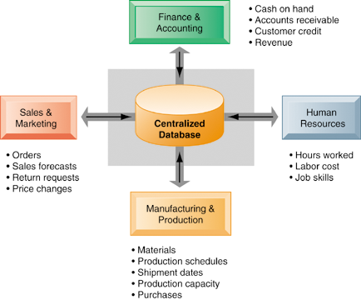
Management Information Systems
Chapter 9 Achieving Operational Excellence and Customer
Intimacy: Enterprise Applications
Enterprise Systems
How Enterprise Systems Work
Figure 9-1
Enterprise systems feature a set of integrated software modules and a central database that enables data to be shared by many different business processes and functional areas throughout the enterprise
Notes:
This graphic illustrates the function of enterprise software to integrate and share data between the different business functions.

Slide 8
Management Information Systems
Chapter 9 Achieving Operational Excellence and Customer
Intimacy: Enterprise Applications
Supply Chain Management Systems
The supply chain
Network of organizations and processes for:
  Procuring raw materials
  Transforming them into products
  Distributing the products
Upstream supply chain:
  Firm’s suppliers, suppliers’ suppliers, processes for managing relationships with them
Downstream supply chain:
  Organizations and processes responsible for delivering products to customers
Notes:
This slide introduces the concept of the supply chain. Supply chain management software is a type of enterprise software for managing complicated supply chains that include many suppliers.
The text gives the example of Nike’s sneakers’ supply chain. What types of firms are in the upstream supply chain? In the downstream supply chain?

Slide 9
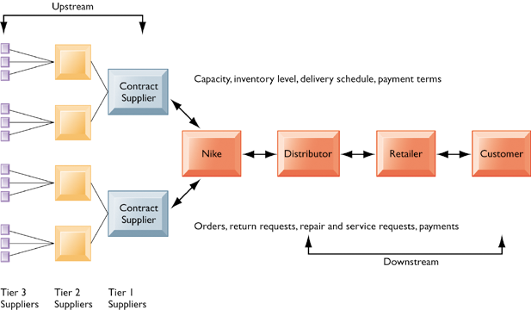
Management Information Systems
Chapter 9 Achieving Operational Excellence and Customer
Intimacy: Enterprise Applications
Supply Chain Management Systems
Nike’s Supply Chain
Figure 9-2
This figure illustrates the major entities in Nike’s supply chain and the flow of information upstream and downstream to coordinate the activities involved in buying, making, and moving a product. Shown here is a simplified supply chain, with the upstream portion focusing only on the suppliers for sneakers and sneaker soles.
Notes:
This graphic illustrates the major entities in Nike’s supply chain. Ask students what the difference is between tier 1, 2, and 3 suppliers.

Slide 10
Management Information Systems
Chapter 9 Achieving Operational Excellence and Customer
Intimacy: Enterprise Applications
Supply Chain Management Systems
Information and supply chain management
  Inefficiencies cut into a company’s operating costs
    Can waste up to 25% of operating expenses
  Just-in-time strategy:
    Components arrive as they are needed
    Finished goods shipped after leaving assembly line
  Safety stock
    Buffer for lack of flexibility in supply chain
  Bullwhip effect
    Information about product demand gets distorted as it passes from one entity to next across supply chain
Notes:
This slide discusses the effects of timely and untimely information on a supply chain.
Ask students what causes inefficiencies in a supply chain (parts shortages, underutilized plant capacity, excessive finished goods inventory, high transportation costs). These are caused by untimely information. Perfect information can results in a just-in-time strategy.
Because of uncertainties, manufacturers keep a safety stock. Another effect of uncertainties is the bullwhip effect.

Slide 11
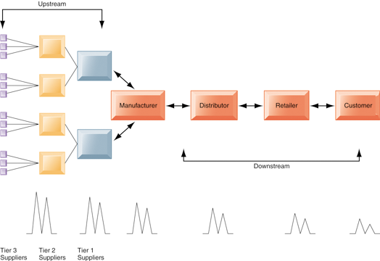
Management Information Systems
Chapter 9 Achieving Operational Excellence and Customer
Intimacy: Enterprise Applications
Supply Chain Management Systems
The Bullwhip Effect
Figure 9-3
Inaccurate information can cause minor fluctuations in demand for a product to be amplified as one moves further back in the supply chain. Minor fluctuations in retail sales for a product can create excess inventory for distributors, manufacturers, and suppliers.
Notes:
This graphic illustrates how a slight rise in demand by customers for an item will cause successive participants to slightly overstock related inventory “just in case”. These changes are amplified as one moves back further in the system.

Slide 12
Management Information Systems
Chapter 9 Achieving Operational Excellence and Customer
Intimacy: Enterprise Applications
Supply Chain Management Systems
Supply chain management systems
  Supply chain planning systems
    Model existing supply chain
    Demand planning
    Optimize sourcing, manufacturing plans
    Establish inventory levels
    Identifying transportation modes
  Supply chain execution systems
    Manage flow of products through distribution centers and warehouses
Notes:
This slide discusses the two main types of supply chain management systems. Ask students to describe what demand planning is (it determines how much product a business needs to make to satisfy customer demand).

Slide 13
Management Information Systems
Chapter 9 Achieving Operational Excellence and Customer
Intimacy: Enterprise Applications
Supply Chain Management Systems
Procter & Gamble Tries to Optimize Inventory
Read the Interactive Session: Technology and then discuss the following questions:
  Why are larger supply chains more difficult to manage? List several reasons.
  Why is supply chain management so important at a company such as P&G?
  How did inventory optimization impact operations and decision making at P&G?
  Why wouldn’t a small company derive much benefit from multi-echelon inventory optimization as a large company? Explain your answer.
Notes:
This Interactive Session looks at the improvements P&G made to their supply chain by implementing a multi-echelon inventory optimization system. Ask students what a multi-echelon network is (networks in which products are located in a variety of locations along their path to distribution, some of which are in different tiers or echelons of the enterprise’s distribution network). What is difficult about this type of network?

Slide 14
Management Information Systems
Chapter 9 Achieving Operational Excellence and Customer
Intimacy: Enterprise Applications
Supply Chain Management Systems
Global supply chains and the Internet
  Before Internet, supply chain coordination hampered by difficulties of using disparate internal supply chain systems
  Enterprise systems supply some integration of internal supply chain processes but not designed to deal with external supply chain processes
  Intranets and Extranets
    Intranets: To improve coordination among internal supply chain processes
    Extranets: To coordinate supply chain processes shared with their business partners
Notes:
This slide discusses how Internet technology has changed supply chains, allowing integration with external supply chains, using intranets and extranets. Ask students what the value is of sharing supply chain information with external supply chain partners.

Slide 15
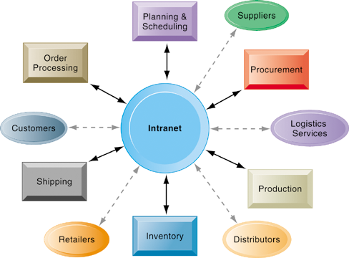
Management Information Systems
Chapter 9 Achieving Operational Excellence and Customer
Intimacy: Enterprise Applications
Supply Chain Management Systems
Intranets and Extranets for Supply Chain Management
Figure 9-4
Intranets integrate information from isolated business processes within the firm to help manage its internal supply chain. Access to these private intranets can also be extended to authorized suppliers, distributors, logistics services, and, sometimes, to retail customers to improve coordination of external supply chain processes.
Notes:
This graphic illustrates how an intranet can be used to integrate information from isolated business processes within the firm.

Slide 16
Management Information Systems
Chapter 9 Achieving Operational Excellence and Customer
Intimacy: Enterprise Applications
Supply Chain Management Systems
Global supply chain issues
  Global supply chains typically span greater geographic distances and time differences
  More complex pricing issues (local taxes, transportation, etc.)
  Foreign government regulations
Internet helps companies manage many aspects of global supply chains
  Sourcing, transportation, communications, international finance
Notes:
This slide discusses the additional complexities experienced by global supply chains. The text cites the example of Koret of California, which
uses e-SPS Web-based software to gain end-to-end visibility into its entire global supply chain. Today’s apparel industry relies heavily on outsourcing to contract manufacturers in China and other low-wage countries. Apparel companies are starting to use the Web to manage their global supply chain and production issues.

Slide 17
Management Information Systems
Chapter 9 Achieving Operational Excellence and Customer
Intimacy: Enterprise Applications
Supply Chain Management Systems
Demand-driven supply chains
  Push-based model (build-to-stock)
    Schedules based on best guesses of demand
  Pull-based model (demand-driven)
    Customer orders trigger events in supply chain
  Sequential supply chains
    Information and materials flow sequentially from company to company
  Concurrent supply chains
    Information flows in many directions simultaneously among members of a supply chain network
Notes:
This slide discusses the fact that SCM systems facilitate efficient customer response, allowing the workings of the business to be driven more by customer demand, moving from push-based, sequential models to pull-based, concurrent models.
Ask students for examples from the text of the pull-based model (Wal-mart, Dell.)

Slide 18
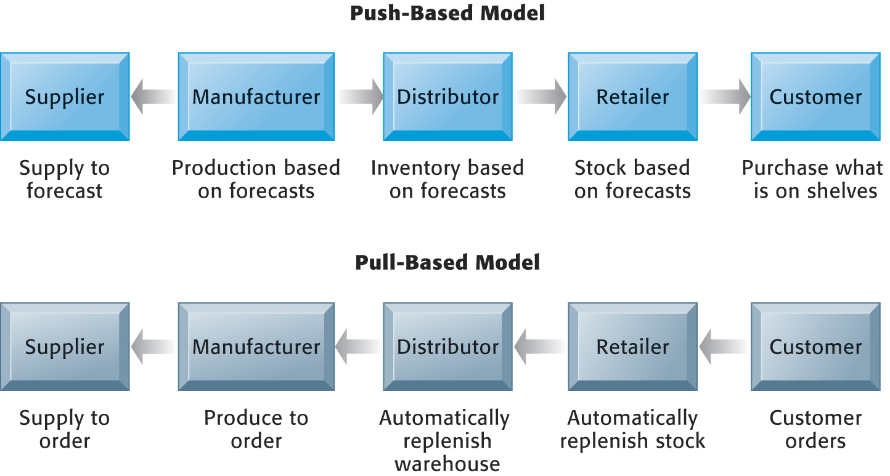
Management Information Systems
Chapter 9 Achieving Operational Excellence and Customer
Intimacy: Enterprise Applications
Supply Chain Management Systems
Push- Versus Pull-Based Supply Chain Models
The difference between push- and pull-based models is summarized by the slogan “Make what we sell, not sell what we make.”
Figure 9-5
Notes:
This graphic illustrates the difference between the earlier, push-based model of supply chains to the pull-based model. Ask students if there are some industries uniquely suited to the pull-based model. How about automobiles, appliances and consumer durables? What are the draw backs of a pull-based model?

Slide 19
Management Information Systems
Chapter 9 Achieving Operational Excellence and Customer
Intimacy: Enterprise Applications
Supply Chain Management Systems
Business Value of Supply Chain Management Systems
Match supply to demand
Reduce inventory levels
Improve delivery service
Speed product time to market
Use assets more effectively
Reduced supply chain costs
Increased sales
Notes:
This slide examines the value of using SCM systems to businesses. Ask students how increase sales can result from a more efficient supply chain.

Slide 20
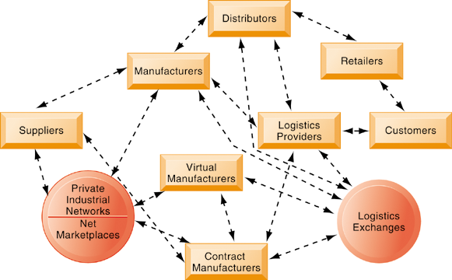
Management Information Systems
Chapter 9 Achieving Operational Excellence and Customer
Intimacy: Enterprise Applications
Supply Chain Management Systems
The Future Internet-Drive Supply Chain
Figure 9-6
The future Internet-driven supply chain operates like a digital logistics nervous system. It provides multidirectional communication among firms, networks of firms, and e-marketplaces so that entire networks of supply chain partners can immediately adjust inventories, orders, and capacities.
Notes:
This graphic illustrates the multidirectional communications within a future supply chain driven by the Internet. Private industrial networks and net marketplaces are discussed in Chapter 10. Private industrial networks are typically a large firm using an extranet to link to its suppliers and other key business partners. Net marketplaces are digital marketplaces based on Internet technology for many different buyers
and sellers

Slide 21
Management Information Systems
Chapter 9 Achieving Operational Excellence and Customer
Intimacy: Enterprise Applications
Customer Relationship Management Systems
What is customer relationship management?
  Knowing the customer
    In large businesses, too many customers and too many ways customers interact with firm
  Customer relationship management (CRM) systems
    Capture and integrate customer data from all over the organization
    Consolidate and analyze customer data
    Distribute customer information to various systems and customer touch points across enterprise
    Provide single enterprise view of customers
Notes:
This slide introduces the concept of customer relationship management as a key function of the business and the use of CRM systems to provide a single place to consolidate and analyze data about the customer. Ask students to provide examples of the different types of customer data that would be captured by a firm. What types of valuable information does the firm need to know about its customers (most profitable, loyal customers.)

Slide 22
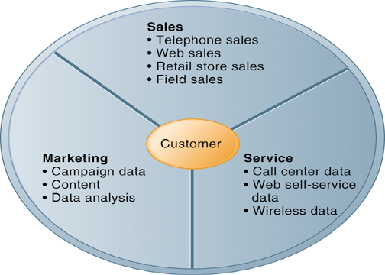
Management Information Systems
Chapter 9 Achieving Operational Excellence and Customer
Intimacy: Enterprise Applications
Customer Relationship Management Systems
Customer Relationship Management (CRM)
Figure 9-7
CRM systems examine customers from a multifaceted perspective. These systems use a set of integrated applications to address all aspects of the customer relationship, including customer service, sales, and marketing.
Notes:
This graphic illustrates the functions found in the integrated applications of a CRM system.

Slide 23
Management Information Systems
Chapter 9 Achieving Operational Excellence and Customer
Intimacy: Enterprise Applications
Customer Relationship Management Systems
CRM software packages
  More comprehensive packages have modules for:
    Partner relationship management (PRM)
    Employee relationship management (ERM)
  Most packages have modules for
    Sales force automation (SFA): Sales prospect and contact information, and sales quote generation capabilities; etc.
    Customer service: Assigning and managing customer service requests; Web-based self-service capabilities; etc.
    Marketing: Capturing prospect and customer data, scheduling and tracking direct-marketing mailings or e-mail; etc.
Notes:
This slide discusses the types of CRM software available, which range from niche tools to full-scale enterprise-wide applications. Ask students for examples of PRM functions (Integrating lead generation, pricing, promotions, order configurations, and availability, tools to assess partners’ performances) and ERM functions (Setting objectives, employee performance management, performance-based compensation, employee training.)

Slide 24
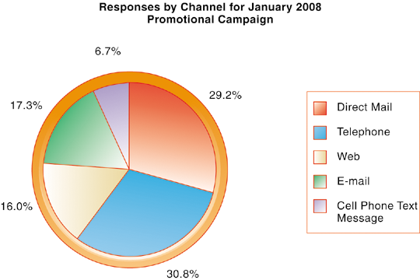
Management Information Systems
Chapter 9 Achieving Operational Excellence and Customer
Intimacy: Enterprise Applications
Customer Relationship Management Systems
How CRM Systems Support Marketing
Figure 9-8
Customer relationship management software provides a single point for users to manage and evaluate marketing campaigns across multiple channels, including e-mail, direct mail, telephone, the Web, and wireless messages.
Notes:
This graphic gives an example of how CRM systems can support marketing by analyzing and evaluating marketing campaigns.

Slide 25
Management Information Systems
Chapter 9 Achieving Operational Excellence and Customer
Intimacy: Enterprise Applications
Customer Relationship Management Systems
Customer Relationship Management Helps Chase Card Services Manage Customer Calls
Read the Interactive Session: Organizations and then discuss the following questions:
  What functions of customer relationship management systems are illustrated in this case?
  Why is the call center so important for Chase Card Services? How could Chase’s call centers help it improve relationships with customers?
Notes:
This Interactive Session discusses the use of a performance and talent management system by Chase to improve call-center response times. It illustrates the effectiveness of using an appropriate information system to improve operational efficiency.

Slide 26
Management Information Systems
Chapter 9 Achieving Operational Excellence and Customer
Intimacy: Enterprise Applications
Customer Relationship Management Systems
Customer Relationship Management Helps Chase Card Services Manage Customer Calls (cont.)
  Describe the problem at Chase call centers. What management, organization, or technology factors contributed to the problem?
  How did using Enkata improve operational performance and decision making? Give examples.
  What management, organization, or technology factors would have to be considered in implementing the Enkata solution?
Notes:
Continuation of the Chase Customer Calls Center Interactive Session.

Slide 27
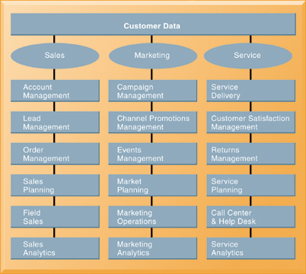
Management Information Systems
Chapter 9 Achieving Operational Excellence and Customer
Intimacy: Enterprise Applications
Customer Relationship Management Systems
CRM Software Capabilities
Figure 9-9
The major CRM software products support business processes in sales, service, and marketing, integrating customer information from many different sources. Included are support for both the operational and analytical aspects of CRM.
Notes:
This graphic illustrates the range of functions included in the sales, marketing, and service modules in a CRM package. As noted in the text, CRM software is business-process driven, incorporating hundreds of business processes thought to represent best practices in each of these areas. To achieve maximum benefit, companies need to revise and model their business processes to conform to the best-practice business processes in the CRM software.

Slide 28
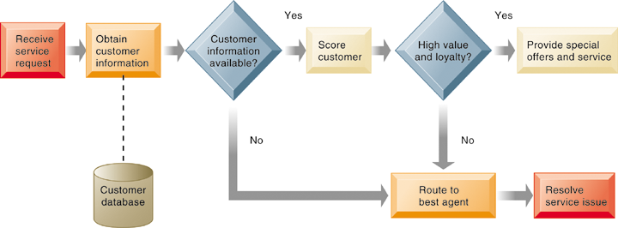
Management Information Systems
Chapter 9 Achieving Operational Excellence and Customer
Intimacy: Enterprise Applications
Customer Relationship Management Systems
Customer Loyalty Management Process Map
This process map shows how a best practice for promoting customer loyalty through customer service would be modeled by customer relationship management software. The CRM software helps firms identify high-value customers for preferential treatment.
Figure 9-10
Notes:
This graphic illustrates how a best practice for increasing customer loyalty through customer service might be modeled by CRM software. What kinds of information might indicate that a customer is loyal or high value?

Slide 29
Management Information Systems
Chapter 9 Achieving Operational Excellence and Customer
Intimacy: Enterprise Applications
Customer Relationship Management Systems
Operational CRM:
  Customer-facing applications such as sales force automation, call center and customer service support, and marketing automation
Analytical CRM:
  Analyze customer data output from operational CRM applications
  Based on data warehouses populated by operational CRM systems and customer touch points
  Customer lifetime value (CLTV)
Notes:
This slide discusses the two main types of CRM software – operational and analytical. Ask students how the CLTV is calculated ( it is based on the relationship between the revenue produced by a specific customer, the expenses incurred in acquiring and servicing that customer, and the expected life of the relationship between the customer and the company.)

Slide 30
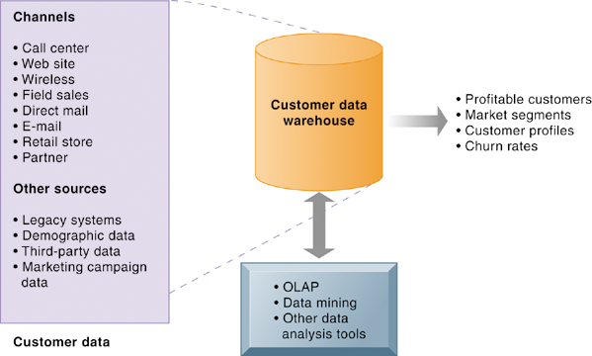
Management Information Systems
Chapter 9 Achieving Operational Excellence and Customer
Intimacy: Enterprise Applications
Customer Relationship Management Systems
Analytical CRM Data Warehouse
Figure 9-11
Analytical CRM uses a customer data warehouse and tools to analyze customer data collected from the firm’s customer touch points and from other sources.
Notes:
This graphic illustrates the main components of analytical CRM. Data is captured from various channels and fed into a customer data warehouse, where OLAP, data mining, and other analysis tools help identify profitable customers, churn rates, etc.

Slide 31
Management Information Systems
Chapter 9 Achieving Operational Excellence and Customer
Intimacy: Enterprise Applications
Customer Relationship Management Systems
Business value of customer relationship management
  Increased customer satisfaction
  Reduced direct-marketing costs
  More effective marketing
  Lower costs for customer acquisition/retention
  Increased sales revenue
  Reduced churn rate
    Churn rate:
      Number of customers who stop using or purchasing products or services from a company.
      Indicator of growth or decline of firm’s customer base
Notes:
This slide discusses the value to businesses of implementing a CRM system. How would marketing be made more effective by using a CRM system?

Slide 32
Management Information Systems
Chapter 9 Achieving Operational Excellence and Customer
Intimacy: Enterprise Applications
Enterprise Applications: New Opportunities and Challenges
Enterprise application challenges
  Highly expensive to purchase and implement enterprise applications – total cost may be 4 to 5 times the price of software
  Requires fundamental changes
    Technology changes
    Business processes changes
    Organizational changes
  Incurs switching costs, dependence on software vendors
  Requires data standardization, management, cleansing
Notes:
This slide looks at the challenges firms face when they implement enterprise applications. Ask students to describe what switching costs are. What problems could result from being dependent on a single software vendor?

Slide 33
Management Information Systems
Chapter 9 Achieving Operational Excellence and Customer
Intimacy: Enterprise Applications
Enterprise Applications: New Opportunities and Challenges
Next generation enterprise applications
  Enterprise solutions / suites:
    Replacing stand-alone enterprise, CRM, SCM systems
    Make these applications more flexible, Web-enabled, integrated with other systems
  Open-source and on-demand applications
    SaaS, Salesforce.com
  Service platform: Integrates multiple applications to deliver a seamless experience for all parties
      Order-to-cash process
  Portals:
    Increasingly, new services delivered through portals
Notes:
This slide looks at the trends in enterprise software. The text cites the example of enterprise solutions from SAP, which combines key
applications in finance, logistics and procurement, and human resources administration into a core ERP component. Businesses then extend these applications by linking to function-specific Web services such as employee recruiting or collections management provided by SAP and other vendors. SAP provides over 500 Web services through its Web site.
Ask students to define open-source, and on-demand. What are the benefits of service platforms?

Slide 34
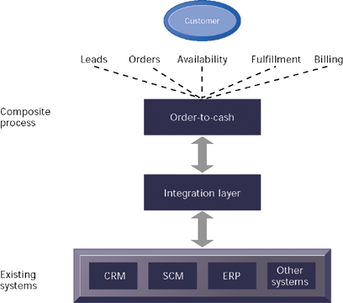
Management Information Systems
Chapter 9 Achieving Operational Excellence and Customer
Intimacy: Enterprise Applications
Enterprise Applications: New Opportunities and Challenges
Order-to-Cash Service
Figure 9-12
Order-to-cash is a composite process that integrates data from individual enterprise systems and legacy financial applications. The process must be modeled and translated into a software system using application integration tools.
Notes:
This graphic illustrates the structure of the order-to-cash service platform, which integrates data and processes from existing systems. Ask students to describe the order-to-cash process.
(The order-to-cash process involves receiving an order and seeing it all the way through obtaining payment for the order. This process begins with lead generation, marketing campaigns, and order entry, which are typically supported by CRM systems. Once the order is received, manufacturing is scheduled and parts availability is verified—processes that are usually supported by enterprise software. The order then is handled by processes for distribution planning, warehousing, order fulfillment, and shipping, which are usually supported by supply chain management systems. Finally, the order is billed to the customer, which is handled by either enterprise financial applications or accounts receivable. If the purchase at some point required customer service, customer relationship management systems would again be invoked.)

Slide 35

All rights reserved. No part of this publication may be reproduced, stored in a retrieval system, or transmitted, in any form or by any means, electronic, mechanical, photocopying, recording, or otherwise, without the prior written permission of the publisher. Printed in the United States of America.
Copyright © 2010 Pearson Education, Inc.
Publishing as Prentice Hall

